Slide 1
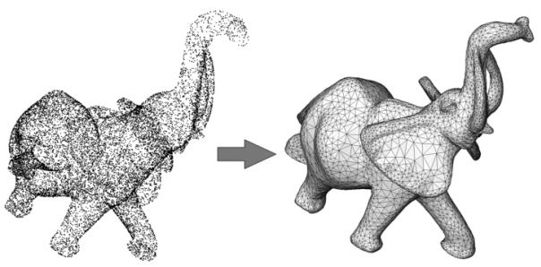
Poisson Surface Reconstruction M Kazhdan, M Bolitho & H Hoppe
Ankit Vijay
Nimit Acharya
Ramji Gupta
Notes:
1

Slide 2
Outline
Introduction
Poisson Reconstruction
How it works?
Evaluation
Results
Conclusions
2

Slide 3
Surface Reconstruction
After scanning an object into a point cloud, we want to get a mesh from those points.
Method should be able to infer the topology of the unknown surface, accurately fit the noisy data, and fill holes reasonably.
Poisson Surface Reconstruction is one of the approaches to obtain smooth and watertight surface.
3

Slide 4
Practical Difficulties
The point samples may not be uniformly distributed over the model surface.
The positions and normals are generally noisy due to sampling inaccuracy and scan misregistration.
And, accessibility constraints during scanning may leave some surface regions devoid of data.
4

Slide 5
Poisson Reconstruction - Approach
It computes a 3D indicator function X(defined as 1 at points inside the model, and 0 at points outside).
The gradient of the indicator function is non-zero only at points near the surface,
At such points, it is taken(proven) to be equal to the inward surface normal.
5

Slide 6
Approach (contd.)
Thus, the oriented point samples can be viewed as samples of the gradient of the model’s indicator function
The problem reduces to finding X whose gradient best approximates a vector field V defined by the input points.
∇X = V
6

Slide 7
Approach (contd.)
If we apply the divergence operator, this problem transforms into a standard Poisson problem: compute the scalar function X whose Laplacian (divergence of gradient) equals the divergence of the vector field V,
ΔX ≡ ∇·∇X = ∇·V
The implicit function X is represented using an adaptive octree rather than a regular 3D grid.
7

Slide 8
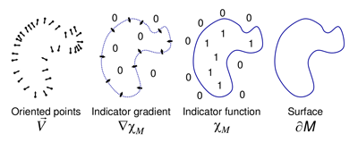
How it works?
∇X = V
ΔX ≡ ∇·∇X = ∇·V
8

Slide 9
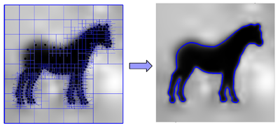
(contd.)
The output scalar function X, represented in an adaptive octree, is then isocontoured using an adaptive marching cubes to obtain the mesh.
9

Slide 10
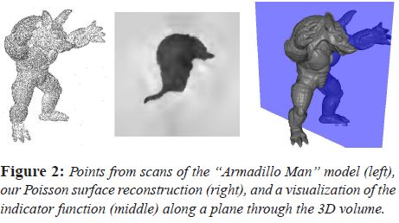
Example
10

Slide 11
Evaluation
We have used Meshlab for experimentation.
The generated mesh is affected by-
Octree Depth: tree-depth that is used for the reconstruction.
SamplesPerNode: specifies the maximum number of sample points that should fall within an octree node. For noise-free data: [1.0, 5.0], noisy data: [15.0, 20.0]
11

Slide 12
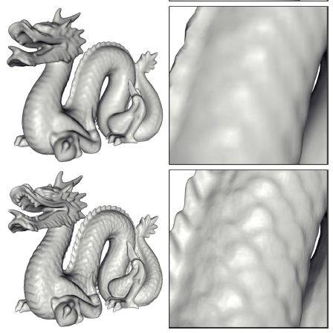
Effect of Octree Depth
higher value => more detailed results.
Lower value => smoothing.(for noisy data)
Higher value =>
more vertices in mesh.
12

Slide 13
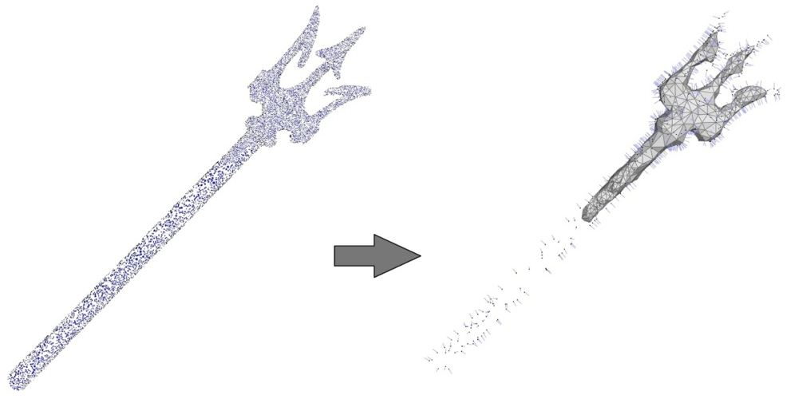
Effect of Dataset
Sparse Sampling
Expects a sufficiently dense cloud.
May not reconstruct the thin sampled features.
13

Slide 14
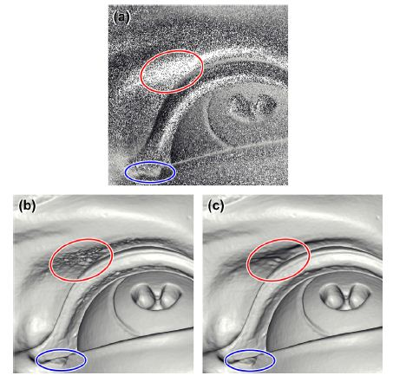
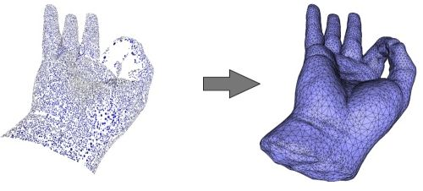
Effect of Dataset
2. Large Holes
Fill holes where data are missing.
But, may use coarser triangulation for filling holes.
14

Slide 15
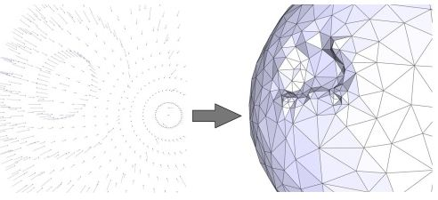
Effect of Dataset
3. Wrongly Oriented Normals
=> incorrect implicit function
=> topological distortion.
15

Slide 16
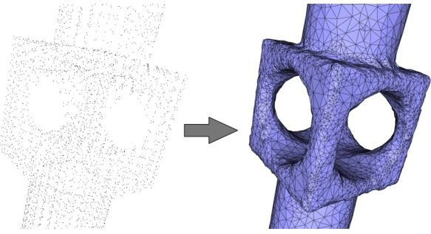
Effect of Dataset
4. Sharp Creases
May not recover the sharp creases and corners present in the inferred surface.
16

Slide 17
Results
Results are available for download in the Links Section.
17

Slide 18
Conclusion
Poisson reconstruction attempts to approximate the indicator function of an inferred solid.
It is fairly robust in filling small holes and dealing with non-uniform data.
18

Slide 19
References
Poisson Surface Reconstruction- Michael Kazhdan, Matthew Bolitho and Hugues Hoppe
CGAL Manual
http://vr.tu-freiberg.de/scivi/
19

Slide 20
Thank you!
20

